Slide 1


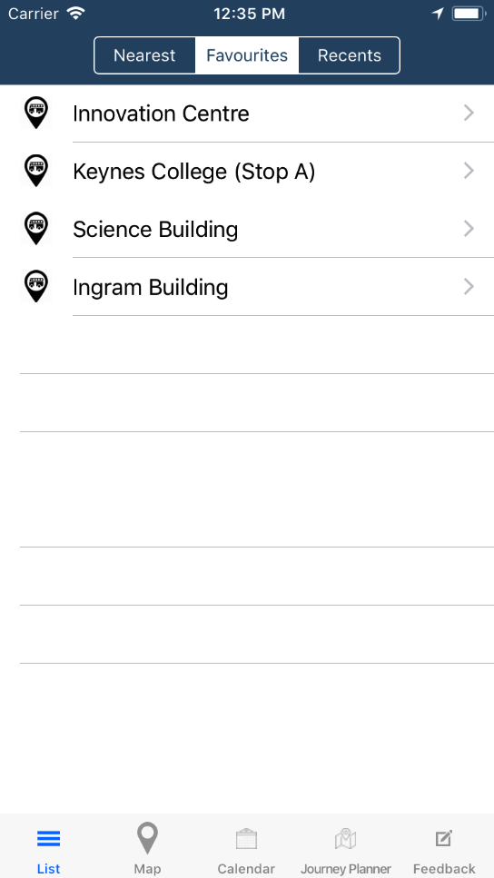
BuzApp
A bus app that facilitates travelling around Kent, providing personalised features for the University of Kent community.
Favourites
Recents
Allows you to store all of your frequently used stops in once place, for quick access
Based on your activity, your recent stops will be stored for easy retrieval
Journey Planner
Calendar
Plan your journey for right now or in the future
Linked to the calendar in your phone, this will tell you when to leave to reach your destination on time
Simple. Essential. Personal.
Marc Jean-Pierre
Sahib Jabbal

